Slide 1

Spice Of Life
Team3
Alex, Sanya, Ayaan

Slide 2
Project Review
Our goal is to create a recipe platform that will make it easier to find meals to make based off of a number of search parameters. People can choose different ingredients to search by, or a certain calorie count. They can even search by different allergies. The application will make finding what to make for dinner easier for anyone who may be in a pinch.

Slide 3
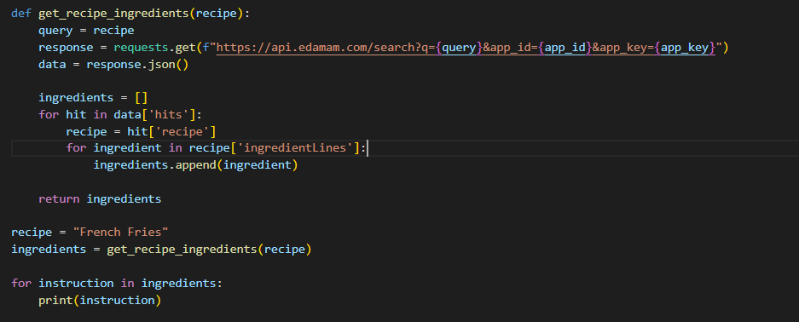
What’s the API
We are using the API provided by Edamnam.
Below is Python code which demonstrates how we can get data from the API, which is returned in a JSON format.
Of course the actual project will be done with PHP, and the information stored in a database.

Slide 4
Tasks
Integrate API search with Javascript and PHP instead of Python
We currently have a python script to search through our API and give back different recipes
This was more of a proof of concept script to prove that we knew how to search for recipes and make this application work and have merit
Make the different pages work together and improve the flow of the website
The overall flow of the site right now is a little clunky, and we’d like to improve the user experience and make it all more streamlined
Make the feed scrolling work and make it appealing
We will have a recipes page with a feed for basic ideas, and we must make the feed appealing and user friendly
Right now it doesn’t really work as intended
We want to make it seem almost instagram-like, something you can just scroll through and absorb content from

Slide 5
More Tasks
Finalize the design and look of the overall application
We like the way that the mock ups look and feel, but we just need to do that to the actual application, and make sure it feels good in practice
Get feedback on the application from real users
Get real people, parents more specifically, to use this application that might need it and see if it actual does what it is intended to fix
Take feedback provided and improve the site
After we are given feedback from users we will improve what we can about the site
This should make the application better and more user friendly

Slide 6
How much work is left
There is a good amount of coding still to be done, but the amount of effort left does not seem to be too much. We have a whole plan in place for the entire website, and with the mock ups, we know what everything will look like. The majority of thinking from this point on will be how to do things on the back end of the development. What is left on the front end is just making sure the feel of everything is good and what we want, and what the users want.

Slide 7
How much work is left (Deadlines)
Finish Project Plan, Mockup: March 16th
Finish Layout of Webpages (Front End): March 27th
API Integrated (Food Search, Food Database, etc): April 3rd
Polish UX: April 10th
Finishing Touches and End Date: April 12th

